Slide 1

Water Quality
-Usha
-Suhas

Slide 2
Current Considerations
Total Dissolved Salts (TDS Sensor)
pH Sensor
Turbidity

Slide 3
TDS
Need and necessity to calibrate TDS Sensors
Two Approaches Planned
1. Setting the Off-Set of the sensors
2. Calibrating the sensors using Standard NaCl Solutions

Slide 4
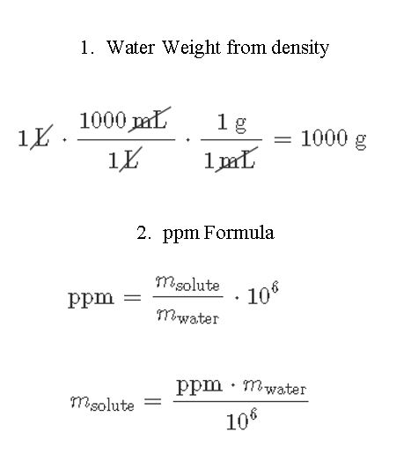

Slide 5
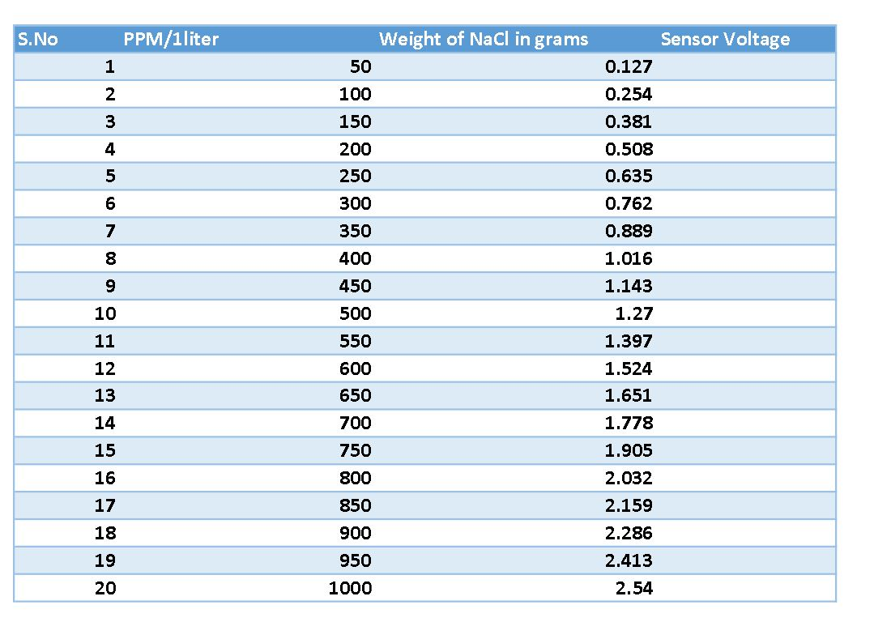

Slide 6
pH Sensor
The sensor has to be dipped in 3N KCl Solution for 8 hours for initial sensor calibration.
Need to Calibrate pH sensor using the Different pH Solutions

Slide 7
Turbidity
Need Standard Turbidity Solutions for Calibration
Formazine Solution is used

Slide 8
Total Requirements
Distilled Water
Measuring Beakers-250,125,500 ml
3N KCl-pH Sensor
Formazine Solution-Turbidity Sensor
Storage Containers Specifications

